Slide 1

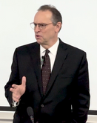
June 2, 2025
William C. Davis
The Leadership Blueprint

Slide 2
The DNA of Leadership:
Identifying Key Characteristics That Make or Break a Great Leader
FBLA 2025 NLC

Slide 3
The DNA of Leadership:
Identifying Key Characteristics That Make or Break a Great Leader
FBLA 2025 NLC

Slide 4
  Leadership is deceptively simple.
  Simple doesn’t mean easy.
  Leadership isn’t theoretical; it’s personal.
  It involves real people, real emotions, and real consequences.

Slide 5
  Building Real Relationships
    Be Present & Engaged:
      Invest time in one-on-one interactions and team meetings to understand each individual’s unique background and aspirations.
    Practice Active Listening:
      Focus fully on what others are saying, ask thoughtful follow-up questions, and confirm your understanding.
    Communicate Transparently:
      Share information openly and honestly to build trust and eliminate misunderstandings.
    Show Consistency & Reliability:
      Follow through on commitments and maintain a regular presence, demonstrating that every relationship is valued.
    Celebrate Individuality:
      Recognize and appreciate the diverse strengths and perspectives that each team member brings.

Slide 6
  Exhibit Sincere Empathy
    Listen with Compassion:
      Go beyond words to understand the feelings behind what is being said, showing genuine care.
    Validate Emotions:
      Acknowledge and affirm the feelings and experiences of your team without judgment.
    Adopt Their Perspective:
      Strive to see situations through your team members’ eyes to fully appreciate their challenges and viewpoints.
    Foster Open Dialogue:
      Create a safe space where everyone feels comfortable sharing their thoughts and concerns.
    Act on Empathy:
      Follow up on emotional cues with supportive actions—whether offering help, resources, or simply a kind word.

Slide 7
  Inspire and Motivate Your Teams
    Articulate a Clear Vision:
      Communicate a compelling and shared vision that unites the team towards common goals.
    Empower Through Trust:
      Delegate responsibilities and provide autonomy, allowing team members to take ownership of their work.
    Recognize & Celebrate Success:
      Regularly acknowledge achievements—big or small—to fuel motivation and reinforce positive behavior.
    Lead by Example:
      Demonstrate passion, resilience, and ethical behavior so that your actions inspire similar commitment in others.
    Invest in their Growth:
      Provide opportunities for professional development and continuous learning to keep the team evolving.

Slide 8
Leadership will always be about humans!

Slide 9
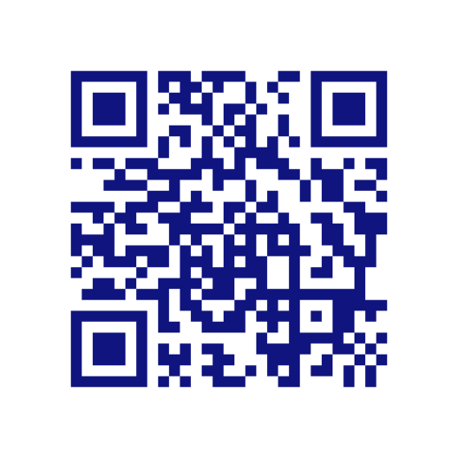
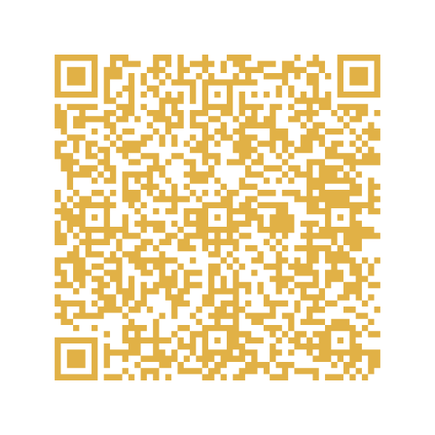
William C Davis
the leadership blueprint
William C Davis
Books

